Slide 1


Scaling Up Nutrition
Business Network (SBN)
KENYA Strategy

Slide 2

What is SUN Business Movement?
The SUN Business Network (SBN) is the world’s leading private sector focused nutrition initiative: a neutral platform to foster partnerships and collaborations.
It aims to engage and mobilize business at a global and national level to act and invest responsibly and to innovate in responsible and sustainable actions
It focuses on emerging markets to improve the consumption of safe food and to make good nutrition more aspirational, accessible, affordable and available for all people

Slide 3
What is SUN Business Movement?
The SUN Business Network (SBN) works alongside partners from Government, civil society, United Nations, scientists and donors thus building the case for greater business engagement in nutrition amongst all stakeholders
In Kenya the network is co-convened by GAIN and WFP

Slide 4
SBN 2019-2023 Strategy
The SBN strategy (2019-2023) is aligned with the Kenya Nutrition Action Plan (KNAP 2018-2022), the Vision 2030, National Policy on Gender and Development 2019, the Kenyan Constitution, BIG4 Agenda.
It has been developed through extensive multi stakeholder consultations with businesses including women owned business and other SUN networks in Kenya.
The strategy charts a clear path for the involvement of private sector and businesses in addressing malnutrition in Kenya

Slide 5
The strategy is also informed by the impacts of COVID-19 on MSMEs, and on the need to support their recovery in the coming years given their key role in sustaining food systems and consequently, nutrition
The Vision of the network is to “Contribute to Reduction of Malnutrition in Kenya” with a Mission to “Enable businesses to supply consistent, safe and nutritious foods to consumers in Kenya”.
The strategy aims to create partnerships that support business operations and facilitate creation of an enabling business environment (focusing on women owned businesses) with specific intervention areas and key activities across 5 Strategic Pillars:

Slide 6
Finance for MSMEs,
Technical Assistance,
Work Force Nutrition,
Policy and Advocacy
Market and Demand.
Starting time frame of key activities under each strategic pillar has been classified as short term (within one year), medium term (within 1-3years) and long term (after 3years).

Slide 7





5 Pillars in the Strategy
BIG 4
Finance for MSMEs
Work-Place Nutrition
FOOD
AND
NUTRITION
SECURITY
Technical Assistance
Market & Demand
Policy and Advocacy

Slide 8
Finance for MSMEs
Intervention area/s | Key Activities | S Short/Medium/Long
Access to Finance | Assess financial needs and gaps of the SME's | S
 | Organize a profile of investable SME's | S
 | Convene a profile of financial service providers and investors (landscaping/mapping) who offer services with terms and conditions suitable for SME’s in rural and urban areas | S
 | Organize capacity building on financial management (book-keeping, checks and controls for payments, pricing, invoices, internal control procedures/policies etc.) | M
 | Facilitate partnerships and linkages of SME's to financial service providers (e.g. banks, investors, civil society organizations, government, donors, etc.) (including pitch competitions) | M

Slide 9
Technical Assistance
Intervention area/s | Key Activities | Short/Medium/Long
Product development, labelling and packaging | Convene nutrition awareness sessions for product development | S
 | Organize development and dissemination of a guideline of food composition tables (FCT) for business | S
 | Facilitate development of tool kits on product labelling and packaging | M
 | Convene capacity building trainings for SMEs on product development (desirability, palatability, nutrient content), labelling, branding and packaging | M
Production, Quality and Safety, Risk assessment, Storage, Waste Management | Capacity build on production, processing/value addition, packaging, energy management, retail, storage, risk assessment and waste management | S
 | Conduct Training on food safety (HACCP) and other standards (ISO) | M
Business Planning and Growth (finance management, compliance, HR, Gender policies, Security etc) | Conduct capacity needs assessment on business planning and growth | S
 | Develop capacity on business planning and growth | M

Slide 10
Work Place Nutrition
Intervention area/s | Key Activities | Start Time Short/Medium/Long
Nutrition Education/Awareness | Dissemination of relevant nutrition guidelines to SBN members (e.g. healthy diets guidelines, etc.) | S
 | Identify and capacity build nutrition champions at company level | S
 | Sensitize SBN members on importance of work force nutrition | M
 | Conduct nutrition awareness via promotional campaigns | M
Healthy diets at work | Assess current situation of work force nutrition in Kenya | S
 | Sensitize business on different models (including simple healthy/snacks) of providing nutritious foods at work place | S
 | Investment case for healthy food at work | L
Work Place Support on Health | Disseminate the work place support guideline and the health act | S
 | Disseminate IEC material on breast feeding, maternal and child nutrition | S
 | Advocate to set up lactation rooms and child care facilities in public and private work places | M

Slide 11
Advocacy
Intervention area/s | Key Activities | Short/Medium/Long
Enabling Business Environment | Identify policies, laws and regulations which exists relevant for food business and put them in one place (One stop shop) | S
 | Enhance awareness of existing and/or future policies (dissemination, Sensitization forums including media, value chain specific, not well known eg commodities exchange) (making them user friendly) | S
SBN Inclusion in relevant nutrition platforms | Link business to nutrition multi stakeholder platforms (MSPs) at national and county level | M
 | Ensure business representations at SUN meetings/forums | M

Slide 12
Market & Demand
Intervention area/s | Key Activities | Start Time Short/Medium/Long
Mainstream nutrition in the food supply chain | Conduct consumer awareness on nutrition and behavior change campaigns | S
Market Growth (Expansion and penetration) | Consolidate existing market information, market research and other relevant researches done in Kenya | S
 | Sensitize businesses on Kenya Mark of Identity (Brand K) to promote utilization of local produce | S
 | Participate and/or Organize Exhibitions/networking forums for information sharing, learning and linkages | S
 | Conduct Market Research for specific value chains | M
 | Support businesses to develop/improve marketing strategy based on results of market feasibility studies | M
 | Facilitate businesses to acquire necessary food certifications/licenses | M
Supply chain management (including during calamities and/or disasters | Train and support businesses on the supply chain aspects (pricing, promotion, people, place, etc.) | M
 | Sensitize businesses on production loss management (including post-harvest losses) | M
 | Facilitate businesses to supply nutritious foods to food deficit areas e.g. link businesses with storage facilities, cold storages, etc. (Food access) | M

Slide 13
Resources Required to implement the Strategy (USD)
Strategic Pillar | 2020 | 2021 | 2022 | 2023 | 2024 | Total/ pillar (USD)
Finance | 39000 | 111700 | 111700 | 111700 | 111700 | 485800
Technical Assistance | 115525 | 292025 | 281025 | 281025 | 281025 | 1250625
Work Force Nutrition | 314506 | 162656 | 138556 | 238556 | 238556 | 1092830
Policies and Advocacy | 43800 | 124550 | 89550 | 84550 | 89550 | 432000
Market and Demand | 102000 | 201600 | 201600 | 201600 | 201600 | 908400
Total/year | 614831 | 892531 | 822431 | 917431 | 922431 | 4,169,655 (GRAND TOTAL)

Slide 14
SBN strategy in the context of Covid-19
The strategy recognizes the fact that COVID-19 has posed a huge burden to not only an already weakened health system in Kenya but also presents adverse effects on businesses with most MSMEs struggling to stay afloat
Poor diet is believed to be responsible for the increased burden of disease with secondary effects of increased food prices and food shortages
This strategy provides a framework for mitigating the collapse of food systems by supporting food businesses and the value chain companies while at the same time strengthening equitable policy responses that can be delivered in short and long term to support continuity and protect key players in food systems in Kenya

Slide 15











SBN Secretariat
Health
Agriculture
Industry, Trade & Cooperatives

Slide 16
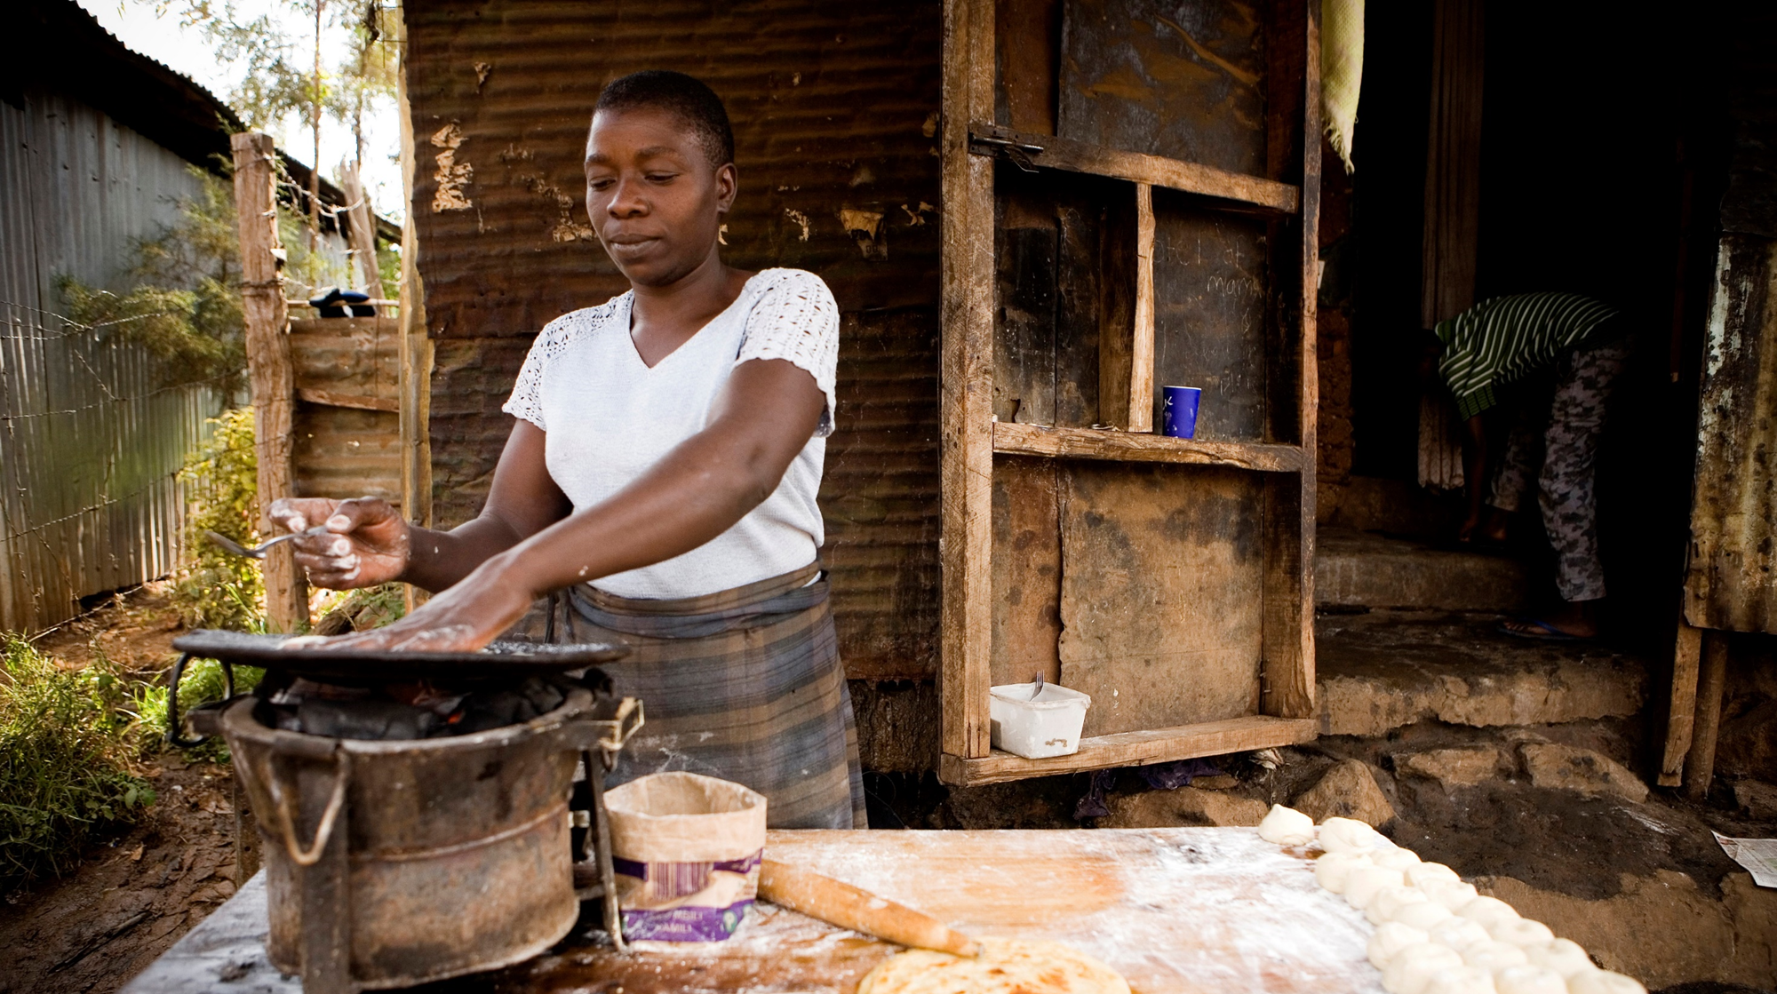
THANK YOU
For more information; sunbusinessnetworkkenya@gmail.com

